Slide 1


Secure Data Transmission over the Internet Using Crytography and Image Steganography
Submitted By
Name : Atiqur Rahman Registration No:16502001117 Session : 2016 - 17 |  | Name : Md. Ahadul Islam Registration No:16502001167 Session : 2016 - 17
Department of Computer Science and Engineering (CSE) Institute of Science and Technology (IST) 26-09-2022

Slide 2
Content List
Introduction
Motivation
Objective
Existing System Overview
Drawbacks of Existing System
Proposed System Design
Proposed System Features
Platform Overview
Implementation
System Testing
Conclusion
Future Work

Slide 3
Introduction
Cryptography:
Art of the science of secret writing.
Scrambles messages so it cannot be understood.
Steganography:
Communicating secret data in an appropriate multimedia carrier. e.g. image, audio, and video files.
Art of hiding information in ways that prevent the detection.

Slide 4
Motivation
The Internet allows for easy dissemination of information over large areas.
This is both a blessing and curse since our important information can spread out all over the world.
To secure our information we have to increase data security.
To play this role we can easily use any encryption algorithm to increase security and hide our information using steganography.

Slide 5
Objective
To create a security system based on image Steganography.
To formulate an algorithm based on data hidden technique in the image to higher.
The quantity of hidden data without affecting the quality of images.
To develop a system based on the algorithm established above.
To collect data and evaluate the accuracy of the algorithm by conducting a study.
To act a new stego-analysis approach on the image to evaluate the new algorithm.

Slide 6
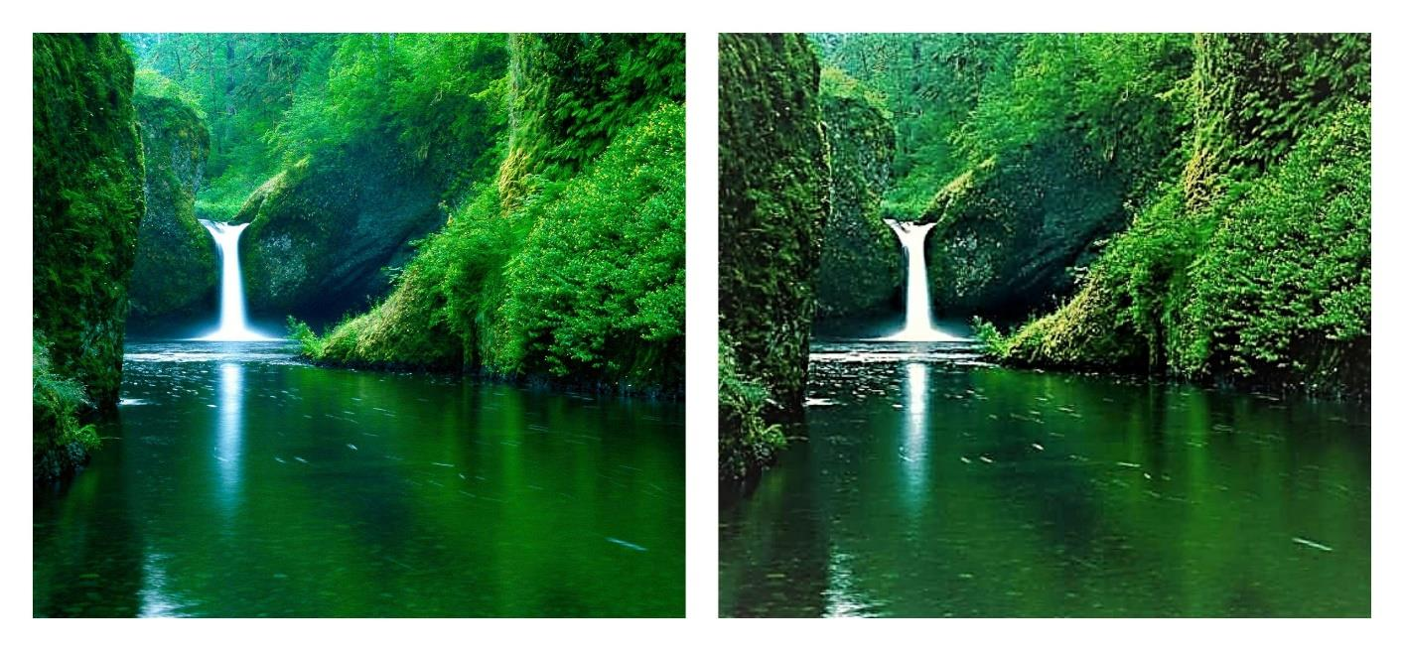
Existing System Overview - Steganography
A. Real Image(PSNR value is 95.11)
B. Stego Image(PSNR value is 76.23)
Figure1 : Distortion in Existing System

Slide 7
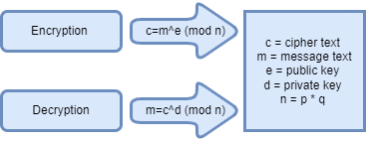
Existing System Overview - RSA
RSA (Rivest–Shamir–Adleman) is a public-key cryptosystem that is widely used for secure data transmission.
Figure 2 : RSA Algorithm

Slide 8
Drawbacks of Existing System
Extremely vulnerable to corruption.
LSB Embedding is relatively insecure.
Robustness against image manipulation is low.
Image can be distorted
Modifying the three colors of a pixel produces a major distortion

Slide 9
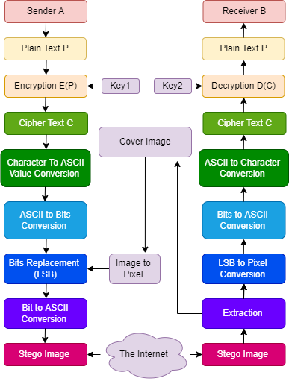
Proposed System Design
Figure3 : Proposed System Workflow

Slide 10
Proposed Technique
Proposed technique of the system divided into three modules.
For Cryptography: Crypto Module and Reverse Crypto Module
For Conversion: Intermediate Module and Reverse Intermediate Module
For Steganography: Stego Module and Reverse Stego Module

Slide 11
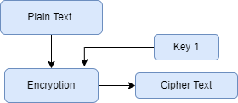
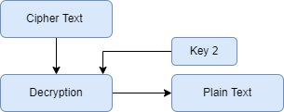
Proposed Technique - Crypto Module and Reverse Crypto Module
Figure 4(A) : Crypto Module
Figure 4(B) : Reverse Crypto Module

Slide 12
Proposed Technique - Intermediate Module and Reverse Intermediate Module
Figure 5(A) : Intermediate Module
Figure5(B) : Reverse Intermediate Module

Slide 13
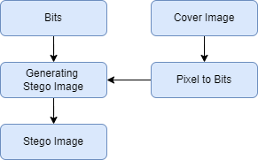
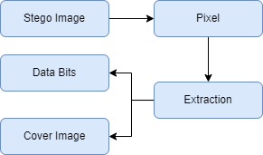
Proposed Technique - Stego Module and Reverse Stego Module
Figure 6(A) : Stego Module
Figure(B) : Reverse Stego Module

Slide 14
Proposed Algorithm (Embedding)- RSA()
Step 1: Create variable to store encrypted value
Step 2: Call Key_generation()
Step 3: Calculate encrypted value and store it
Step 4: Return encrypted ASCII value of each character
Step 5: Exit()

Slide 15
Proposed Algorithm (Extraction) - RSA()
Step 1: Create variable to store encrypted value
Step 2: Call Key_generation ()
Step 3: Calculate decrypted value and store it
Step 4: Return decrypted ASCII value of each character
Step 5: Exit()

Slide 16
Proposed Algorithm (Embedding) - key_generation()
Step 1: Select two large primes p and q such that p & q.
Step 2: n ← p x q
Step 3: φ (n) ← (p-1) x (q-1)
Step 4: Select e such that 1 < e < φ (n) and e is co-prime to φ(n).
Step 5: [d is inverse of e modulo φ (n)] d ← e-1 mod φ (n)
Step 6: [To be announced publicly] Public_key ←(e, n )
Step 7: [ To be kept secret] Private_key ← ( d, n )
Step 8: Return Public_key and Private_key

Slide 17
Proposed Algorithm (Extraction )- key_generation()
Step 1: Select two large primes p and q such that p & q.
Step 2: n ← p x q
Step 3: φ (n) ← (p-1) x (q-1)
Step 4: Select e such that 1 < e < φ (n) and e is co-prime to φ (n).
Step 5: [d is inverse of e modulo φ (n)] d ← e-1 mod φ (n)
Step 6: [To be announced publicly] Public_key ←(e, n)
Step 7: [ To be kept secret ] Private_key ← ( d, n )
Step 8: Return Public_key and Private_key.

Slide 18
Proposed Algorithm (Embedding) - main()
Step 1: Select a cover image
Step 2: store each pixel of image into 3D array (RGB)
Step 3: Create a message and store it in a variable
Step 4: Call msg_binary (message)
Step 5: while msg_binary_value.length != 0
5.a Select one red pixel of array
5.b Convert the red pixel into 8 bit corresponding binary
5.c If last bit of red pixel = 0: call green_pixel (row,column)
5.d If last bit of red pixel = 1: call blue_pixel(row,column)
Step 6: Store the new stego_image
Step 7: Exit()

Slide 19
Proposed Algorithm (Extraction)- main()
Step 1: Select a stego image.
Step 2: Compute length of message.
Step 3: Create a 2D array variable to store the last bit.
Step 4: While (length != 0)
4.a Select red pixel of array
4.b Convert the red pixel into 8 bit corresponding binary
4.c If last bit of red pixel = 0: call green_pixel (row,column)
4.d If last bit of red pixel = 1: call blue_pixel(row,column)
Step 5: Compute the ASCII value of bit.
Step 6: call RSA().
Step 7: Convert the ASCII value int character
Step 8: Exit()

Slide 20
Proposed Algorithm (Embedding)- msg_binary(message)
Step 1: Create two variable which can store integer value and binary value of message
Step 2: Call RSA (message)
Step 3: Convert the ASCII value into corresponding binary value and store it into variable
Step 4: Return binary bit
Step 5: Exit()

Slide 21
Proposed Algorithm (Embedding) - green_pixel(r,c) and blue_pixel(r,c)
Step 1: Select one green pixel of image according to row and column of red pixel
Step 2: convert the pixel integer value into 8 bit corresponding binary
Step 3: select last bit of binary
Step 4: insert the value into last bit
Step 5: convert the binary value into corresponding ASCII value
Step 6: put the ASCII value into image
Step 1: Select one blue pixel of image according to row and column of red pixel
Step 2: convert the pixel integer value into 8 bit corresponding binary
Step 3: select last bit of binary
Step 4: insert the value into last bit
Step 5: convert the binary value into corresponding ASCII value
Step 6: put the ASCII value into image

Slide 22
Proposed Algorithm (Extraction) - green_pixel(r,c) and blue_pixel(r,c)
Step 1: select one green pixel of image according to row and column of red pixel
Step 2: convert the pixel integer value into 8 bit corresponding binary
Step 3: select last bit of binary
Step 4: select the last bit of green pixel
Step 5: put the bit into variable
Step 6: exit()
Step 1: select one blue pixel of image according to row and column of red pixel
Step 2: convert the pixel integer value into 8 bit corresponding binary
Step 3: select last bit of binary
Step 4: select the last bit of blue pixel
Step 5: put the bit into variable
Step 6: exit()

Slide 23
Proposed System Features
Authentication .
Data privacy.
Data integrity.
Image sized hiding capacity.
Perceptual transparency.
Robustness.
Temper Resistence.
Less significant distortion and
Continuous uses of same image.

Slide 24
Platform Overview
Hardware Requirement
Minimum 2 GB of RAM
Dual core processor
120 GB of ROM
Software Requirement
32/64 Bit Operating System
Python Version 3
Tkinte GUI framework
MS-VScode (Latest Version)

Slide 25
Implementation
Tkinter framework provides Python users with a simple way to create GUI elements using the widgets found in the Tk toolkit .
Python is commonly used for developing websites and software, task automation, data analysis, and data visualization
NumPy is a Python library used for working with arrays.
OpenCV - Python is a library of Python bindings designed to solve computer vision problems.
Python Imaging Library (expansion of PIL) is image processing package for Python language .

Slide 26
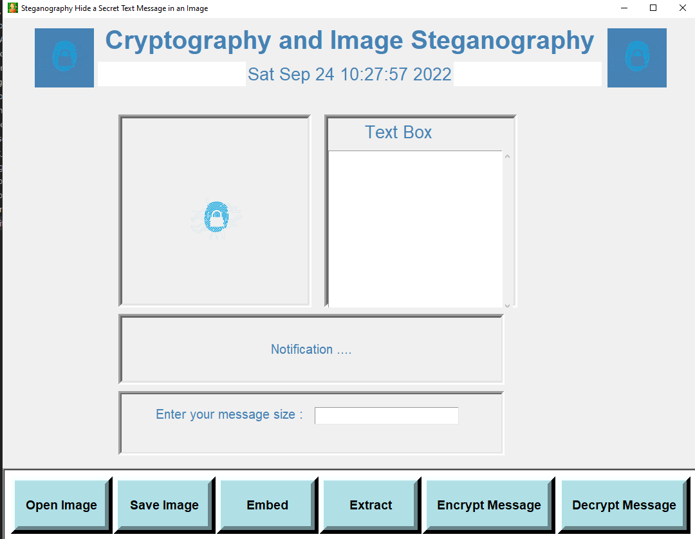
Implementation (Cont.)
Figure 7: User Interface

Slide 27
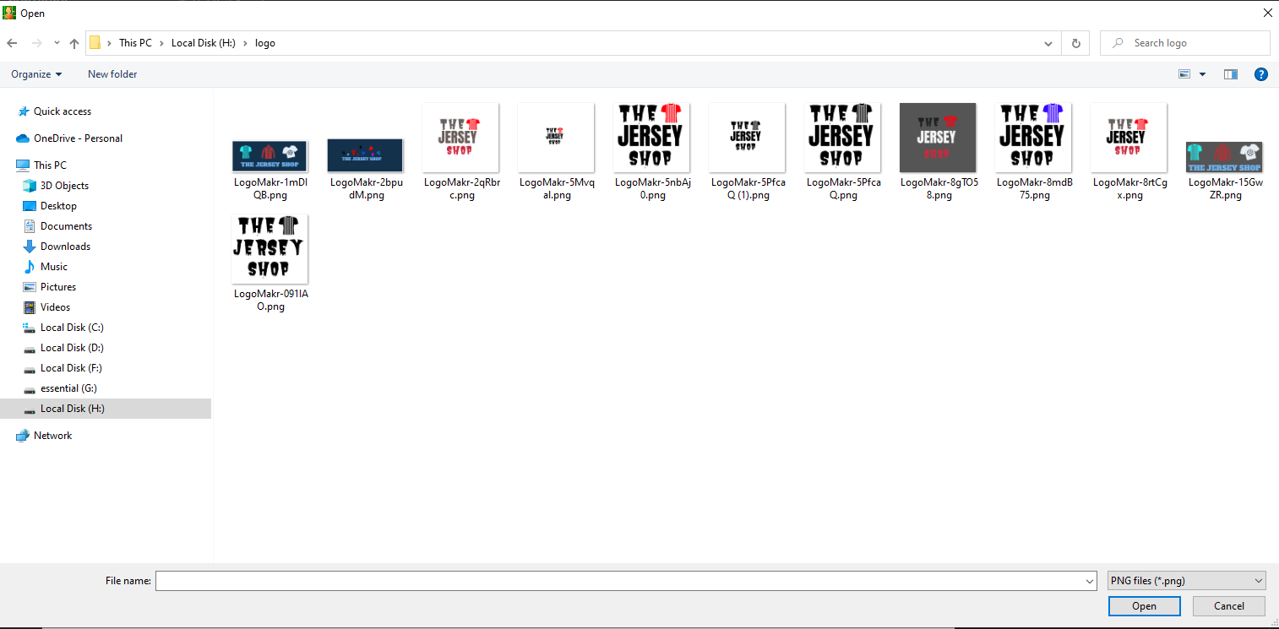
Implementation (Cont.)
Figure 8 : Open Image

Slide 28
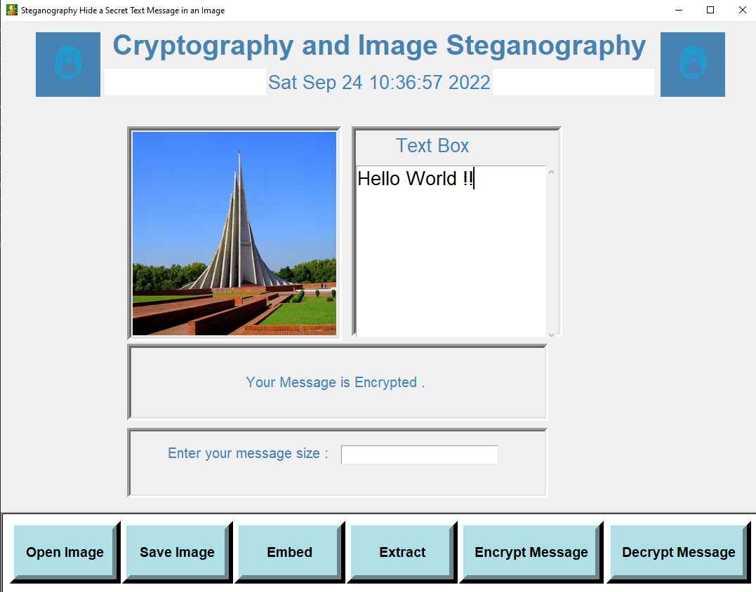
Implementation(Cont.)
Figure 9: Message Encryption

Slide 29
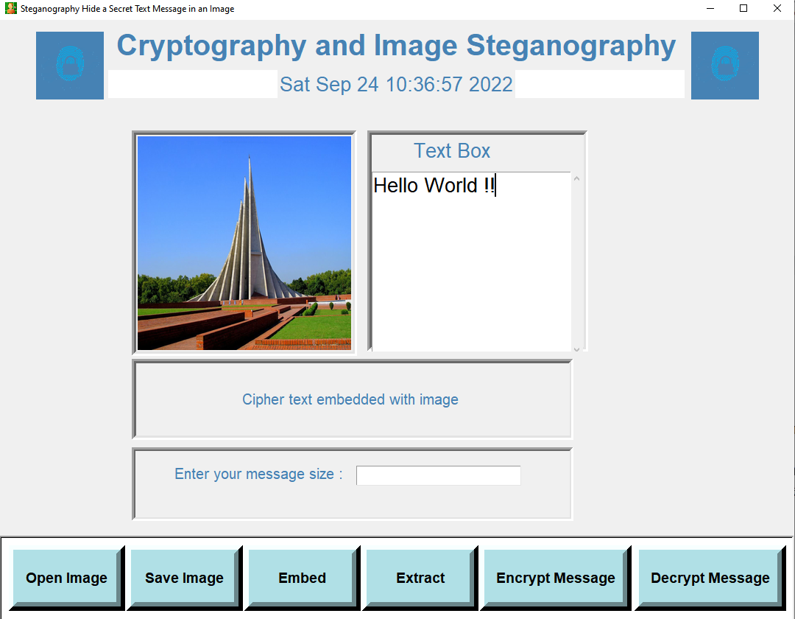
Implementation (Cont.)
Figure 10: Embedding message with image

Slide 30
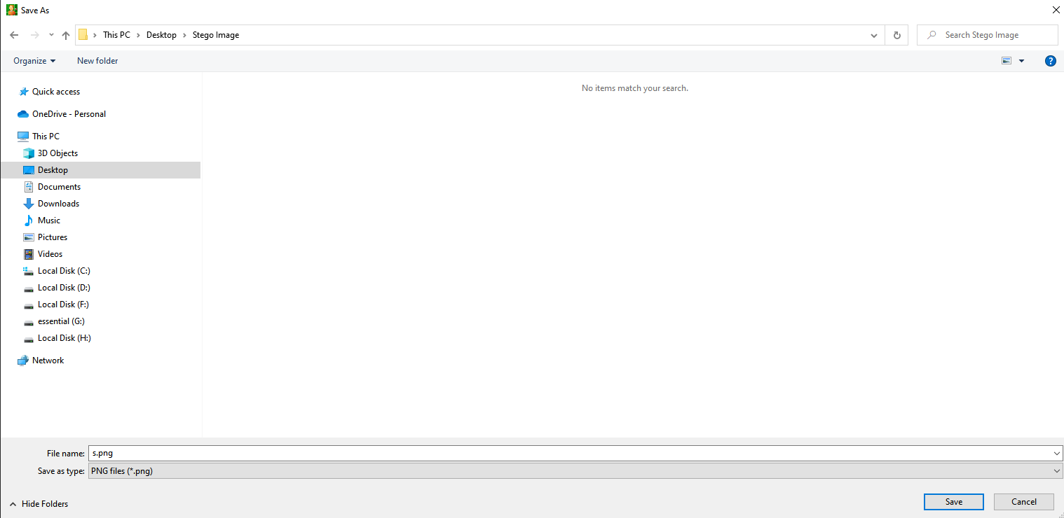
Implementation (Cont.)
Figure 11: Save Image

Slide 31
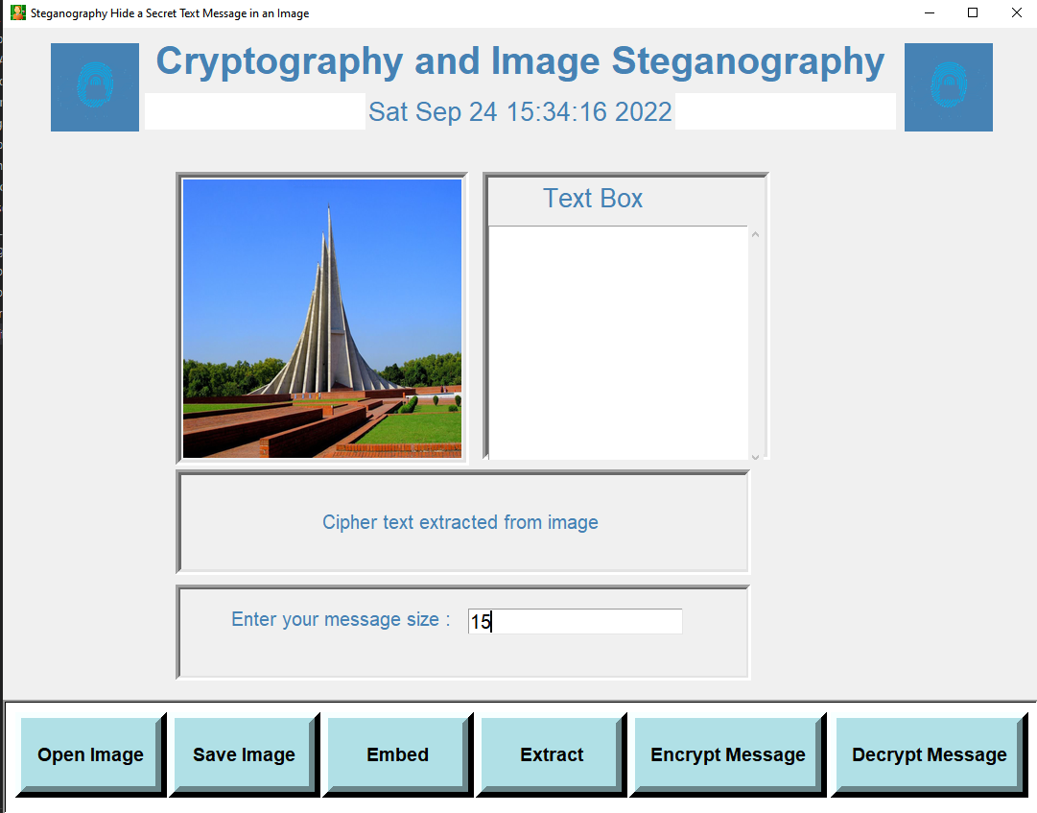
Implementation (Cont.)
Figure 12: Extract Data

Slide 32

Implementation (Cont.)
Figure 13: Decryption

Slide 33
Comparison
Features | Exisiting System | Proposed System
Authentication | NO | NO
Confidentiality | NO | YES
Distortion | More | Less
Integrity | NO | YES
Table 1 : Comparison

Slide 34
System Testing
Unit Testing
Integration Testing
PSNR Value Comparison
Histogram Comparison

Slide 35
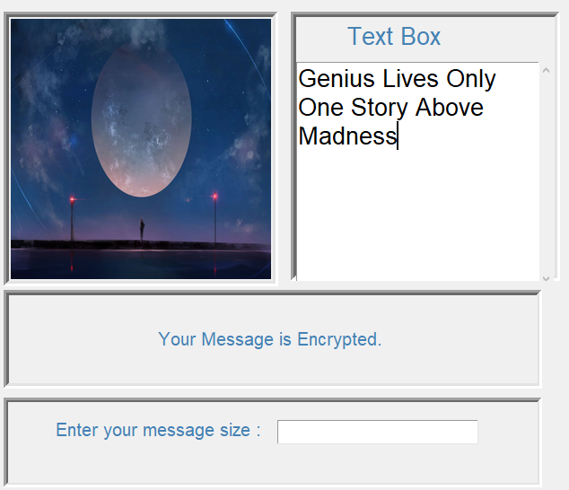
System Testing - Unit Test
Figure14 : Encryption part

Slide 36
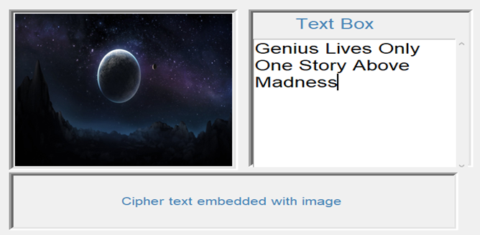
System Testing - Unit Test (Cont.)
Figure 15 : Embedding part

Slide 37
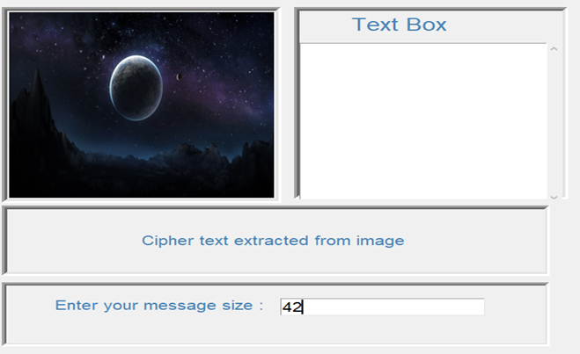
System Testing - Unit Test (Cont.)
Figure 16 : Extraction part

Slide 38
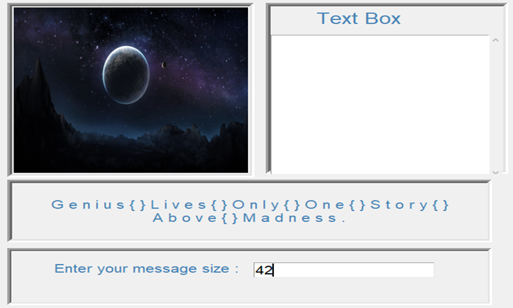
System Testing - Unit Test (Cont.)
Figure 17 : Decryption part

Slide 39
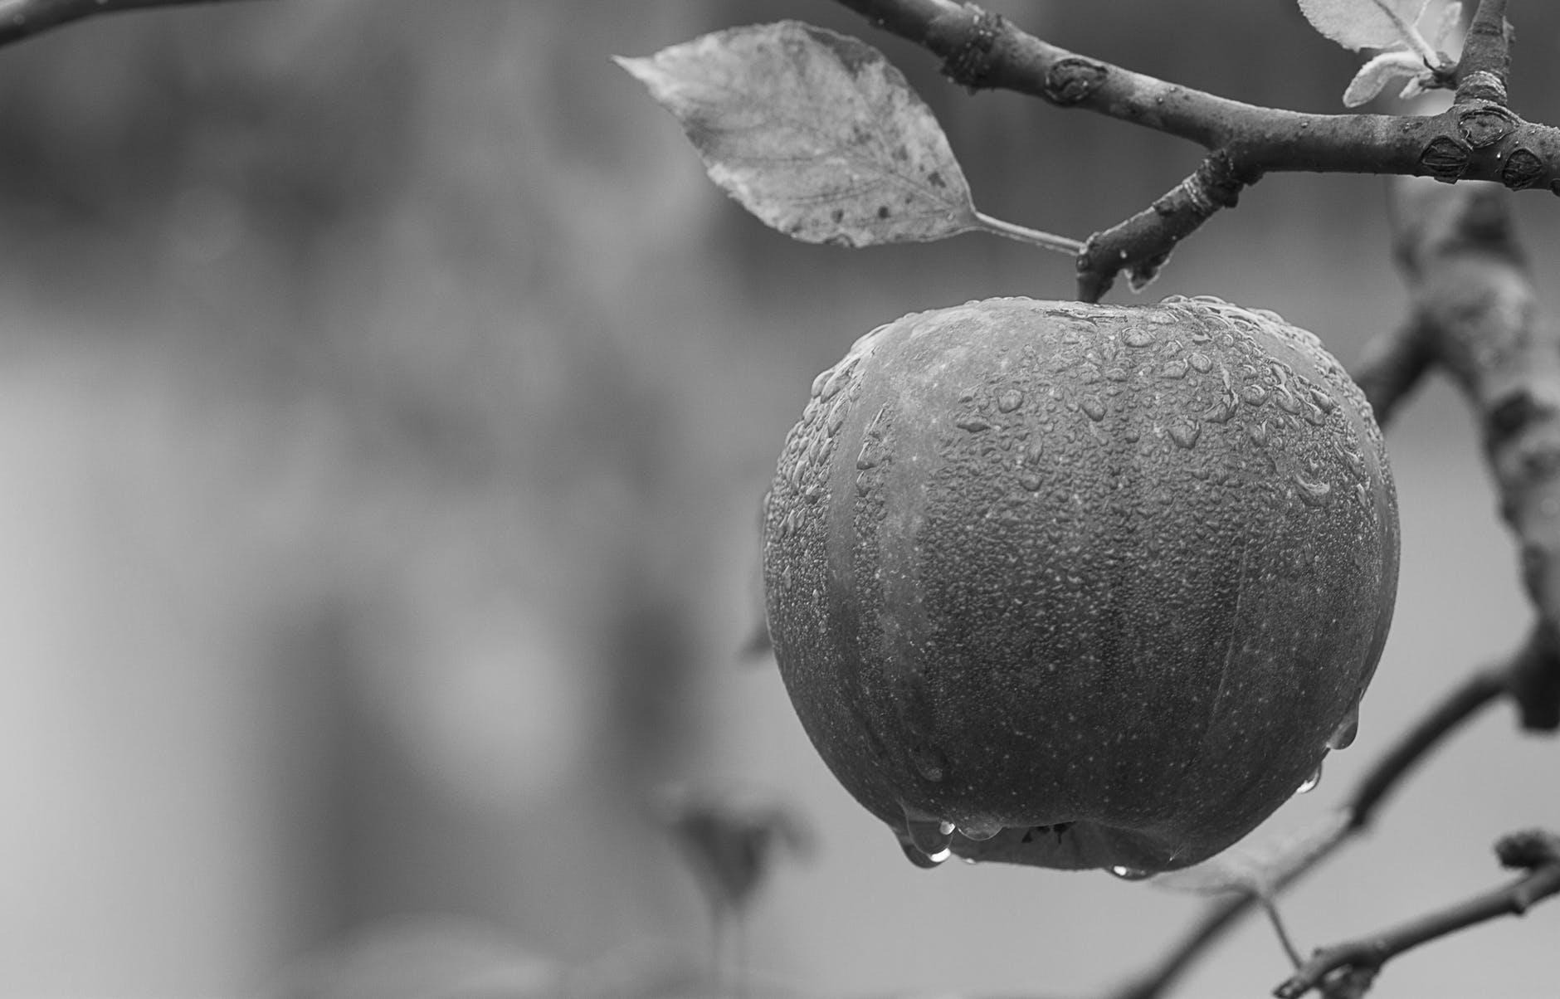








System Testing – PSNR value comparison (Cont.)
Format | Original Image | Stego Image | PSNR
Grayscale |  |  | 90.81db
JPEG |  |  | 104.46db
PNG |  |  | 106.10db
BMP |  |  | 88.49db
Table 2 : PSNR Values Comparison

Slide 40
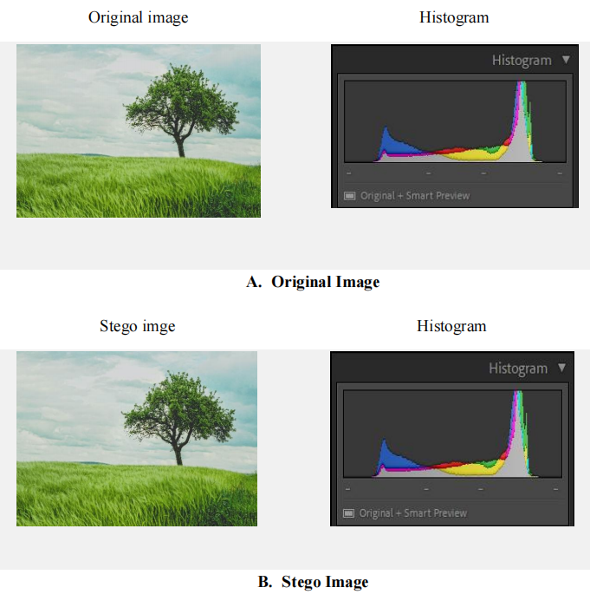
System Testing – Histogram value Comparison(Cont.)
Figure 18 : Histogram Comparison for JPEG format

Slide 41
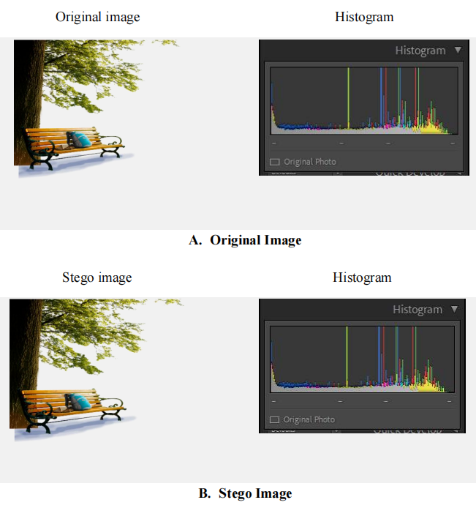
System Testing – Histogram value Comparison(Cont.)
Figure 19 : Histogram Comparison for PNG format

Slide 42
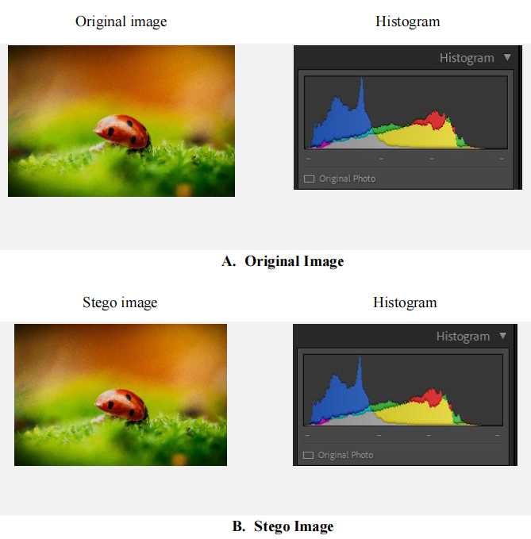
System Testing – Histogram value Comparison(Cont.)
Figure 20 : Histogram Comparison for BMP format

Slide 43
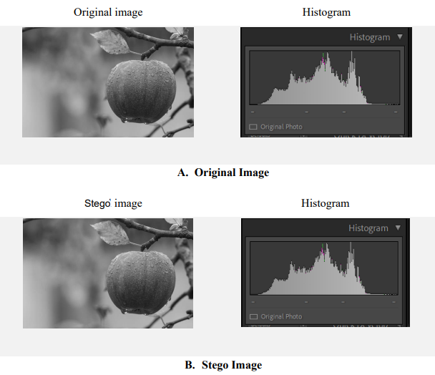
System Testing – Histogram value Comparison(Cont.)
Figure 21 : Histogram Comparison for Grayscale format

Slide 44
Conclusion
In this project focuses on the use of cryptography and steganography withing digital images (jpeg, BMP and PNG) using LSB Substitution.
In our proposed method,
Cryptography used to encrypt information and
Steganography to hide information into cover image.
This process provides a new dimension for image steganography.

Slide 45
Future Work
Our future plan for this project:
Make it more reliable to user
Work on our UI for more user friendly
Digitized it to do some pretty creative things
Work on other multimedia steganography

Slide 46
Thank You

